Slide 1
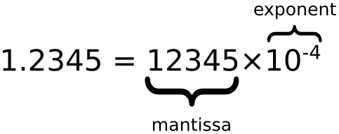
Floating point
Addition and subtraction
FP addition is not associative

Slide 2
Addition and subtraction
A simple method to add floating-point numbers is to first represent them with the same exponent.
In the example below, the second number is shifted right by three digits, and we then proceed with the usual addition method:
123456.7 = 1.234567 × 10⁵
101.7654 = 1.017654 × 10² = 0.001017654 × 10⁵
Hence:
123456.7 + 101.7654 =
1.234567 × 10⁵ + 1.017654 × 10²
= 1.234567 × 10⁵ + 0.001017654 × 10⁵
= (1.234567 + 0.001017654) × 10⁵
= 1.235584654 × 10⁵

Slide 3
FP addition is not associative: (a + b) + c ≠ a + (b + c)
Using 7-digit decimal arithmetic:
a = 1234.567, b = 45.67834, c = 0.0004
(a + b) + c: a + (b + c):
1234.567 (a) 45.67834 (b)
+ 45.67834 (b) + 0.0004 (c)
------------------ --------------------
1280.24534 rounds to 1280.245 45.67874
1280.245 (a + b) 1234.567 (a)
+ 0.0004 (c) + 45.67874 (b + c)
-------------------- -------------------
1280.2454 rounds to 1280.245 1280.24574 rounds to 1280.246

Slide 4
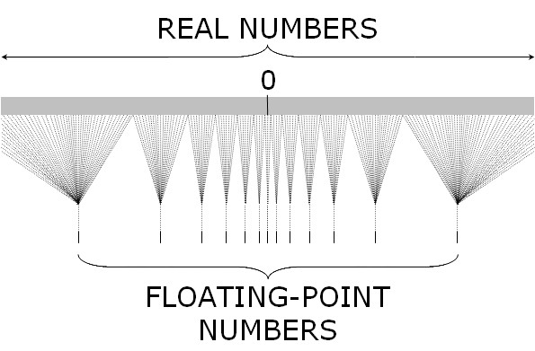
(A + B) + C ≠ A + (B + C)

Slide 5


